Slide 1

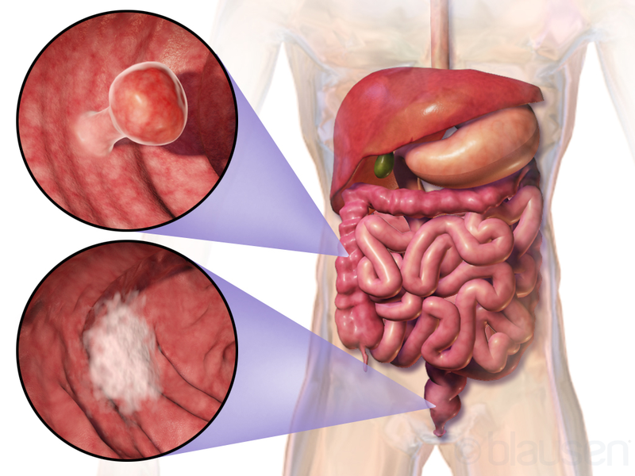
Identifying the most appropriate parametric survival model with the least estimation error and applying it to determine factors related to survival of patients with colon cancer
Background and purpose: This study aimed to identify the best parametric survival model with the least error for estimating the survival of patients with colon cancer.
Materials and methods: In this historical cohort study, the data of 761 patients with colon cancer in Mazandaran province who were referred during 2012-2017 and followed up until 2019 were reviewed.
Finding: The three-, five-, and seven-year survival rates were 70, 49, and 37%, respectively. In this study, the Weibull parametric model was recognized as the best model with the highest accuracy and the lowest error in predicting survival and identifying the most important related factors.

